Slide 1
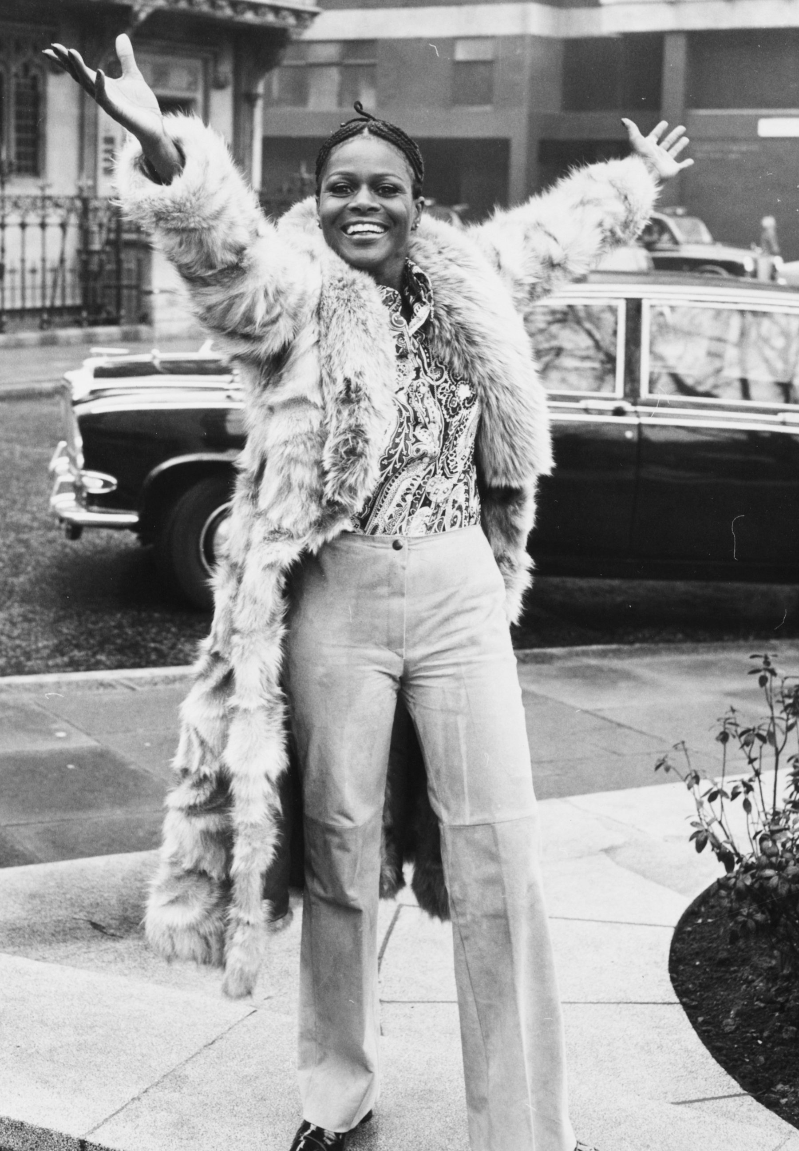
Cicely tyson
Stories of Excellence
Student health & Human services
Office of human relations, diversity & equity
July 2022

Slide 2
Welcome which do you prefer?
Snow
Rain
Notes:
Engage the students in this check in question.

Slide 3
Objectives
Learn about the life and legacy of Cicely Tyson.
Review Cicely Tyson's advocacy.
Reflect on the ways in which Cicely Tyson impacted the film industry.
Notes:
Read aloud for the students

Slide 4
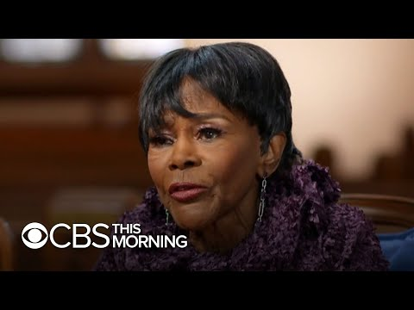
Who is cicely tyson?
Notes:
https://www.youtube.com/watch?v=f6US9geaSmA
Play the video for the students (9:39)
Let the students know that this piece aired on CBS This Morning on Tuesday January 26, 2021, and Cecily Tyson died on January 28, 2021.

Slide 5
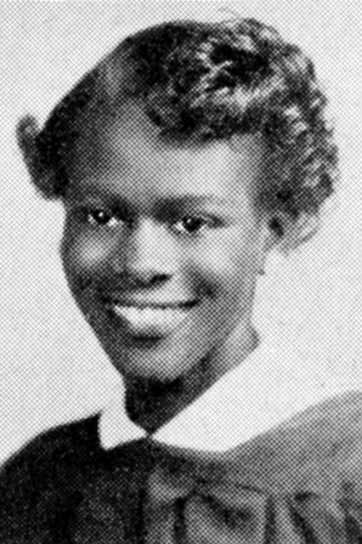
Early life
Cicely Tyson was born in New York City in 1924.
Cicely's parents were immigrants from the West Indies and came to America in 1919.
Cicely had two siblings.
When she was 17 years old, Cicely gave birth to her daughter.
Notes:
Read the slide aloud for the students.

Slide 6
reflection
Do you think having children means people have to stop pursuing their dreams?
In the video, Cicely stated that her mother made her move out of the house when she decided she wanted to become an actress.
At the time, Cicely was trying to raise her daughter as well.
Notes:
Invite the students to engage in the reflection question

Slide 7
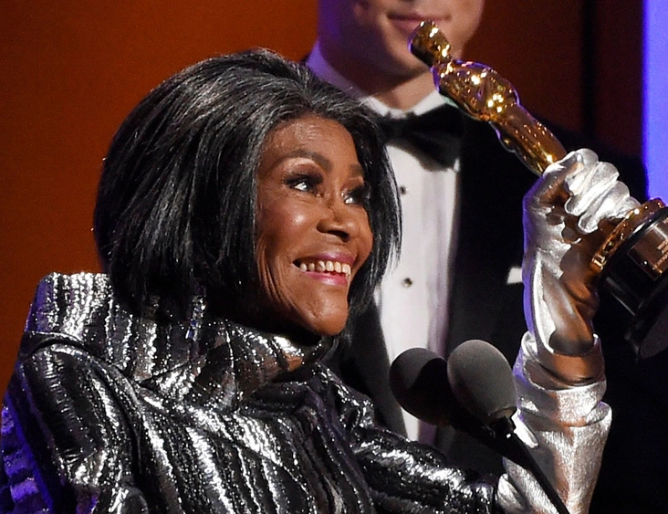
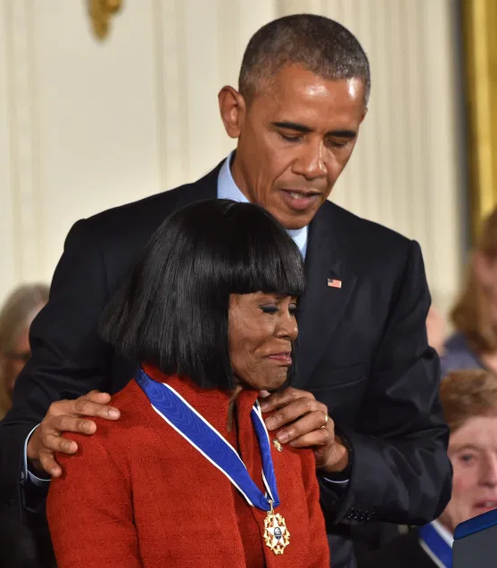
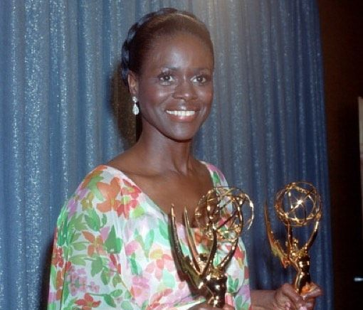
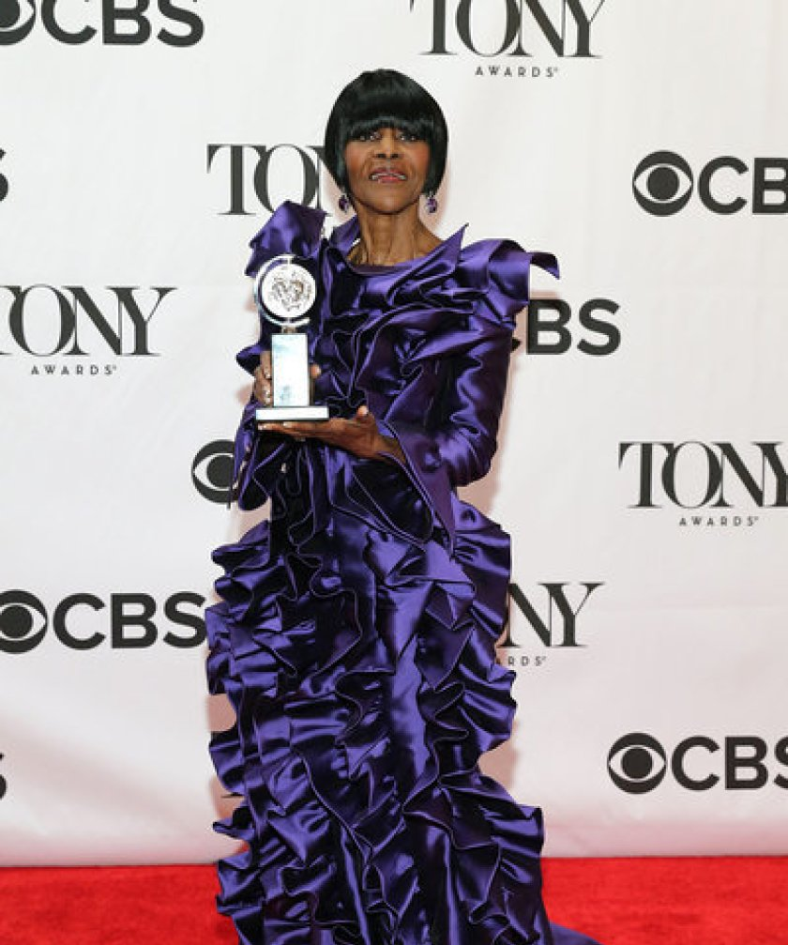
Awards and recognition
Cicely appeared in more than 100 film, television and stage roles.
She won three Emmy Awards, many awards from Civil Rights and Womens groups, and an honorary Oscar.
At 88 years old, Cicely became the oldest person ever to win a Tony award.
In 2016, Cicely received the Presidential Medal of Freedom from then-President Barack Obama.
In 2020 Cicely was inducted into the Television Hall of Fame and won a career achievement Peabody Award.
Notes:
Read the slide aloud for the students.

Slide 8
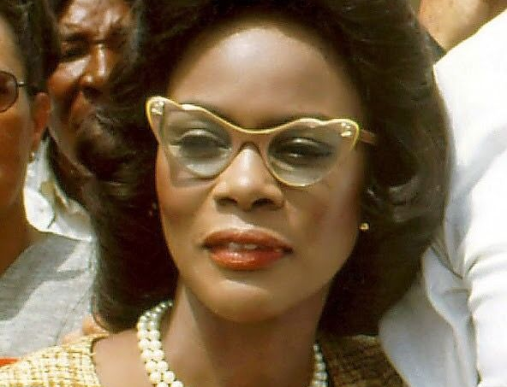
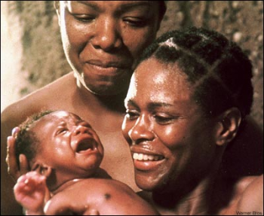
Groundbreaking roles
From early on in her career, Cicely refused to take parts in movies, television or on the stage that demeaned Black people.
Cicely often went without work as she awaited roles she thought would showcase the dignity and humanity of the Black community.
Cicely was openly critical of films and television shows that cast Black characters as criminal, servile or immoral.
Some of Cicely's notable roles included Kunta Kinte's mother in "Roots", Corretta Scott King in "King", Harriet Tubman in "A Woman Called Moses", Marva Collins in "The Marva Collins Story" and Jane Pittman in "The Autobiography Miss Jane Pittman".
Notes:
Read the slide aloud for the students.

Slide 9
reflection
Resources indicate that because of this, Cicely often went without work while awaiting roles she deemed appropriate.
Throughout her career, Cicely courageously insisted that she only wanted roles that portrayed Black women with dignity and respect.
What kind of impact, if any, do you think that stance has had on the movie/television industry?
Notes:
Invite the students to engage in the reflection question

Slide 10
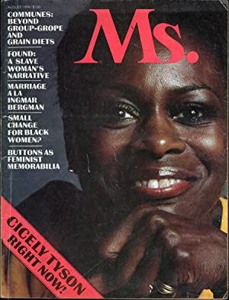
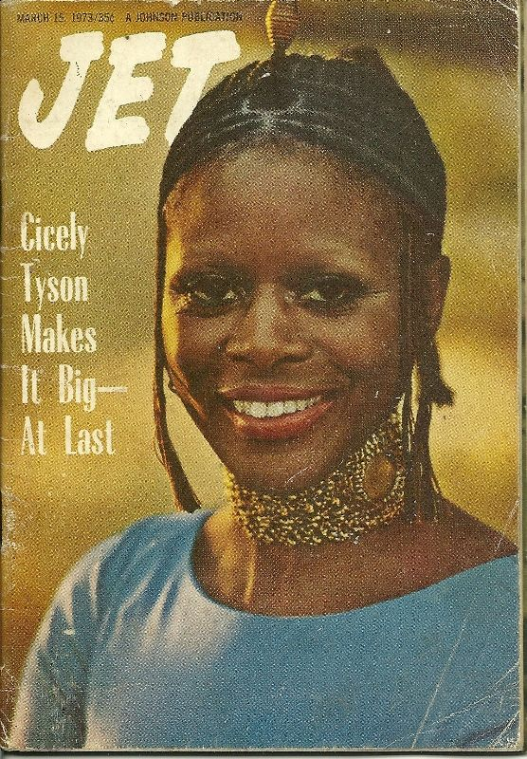
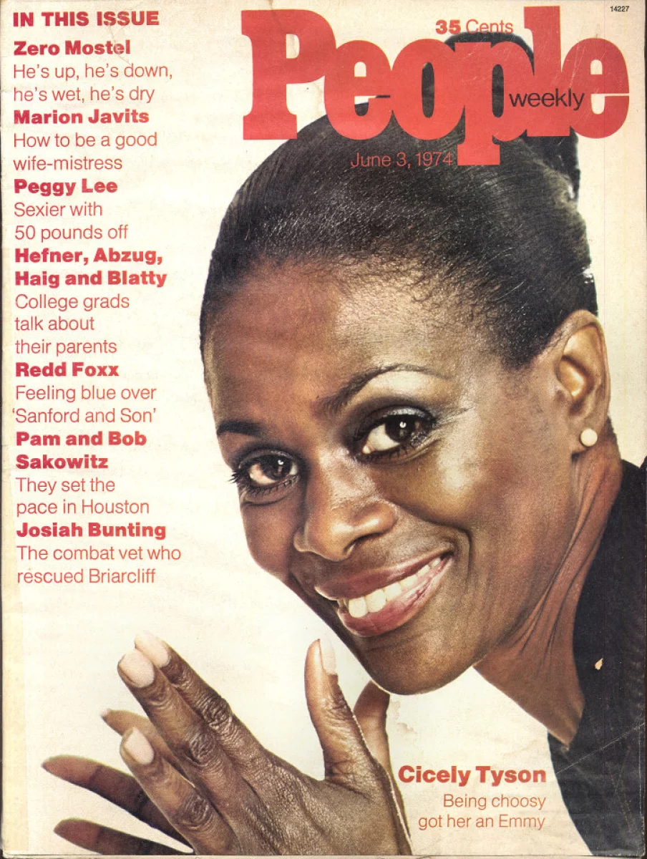
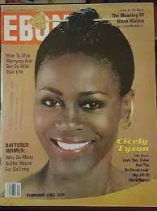
Black is beautiful
For many Americans, Cicely was an idol of the Black is Beautiful movement.
Cicely would frequently wear an African turban and caftan.
Cicely is also recognized as encouraging and inspiring Black women to embrace their own standards of beauty.
Notes:
Read the slide aloud for the students.

Slide 11
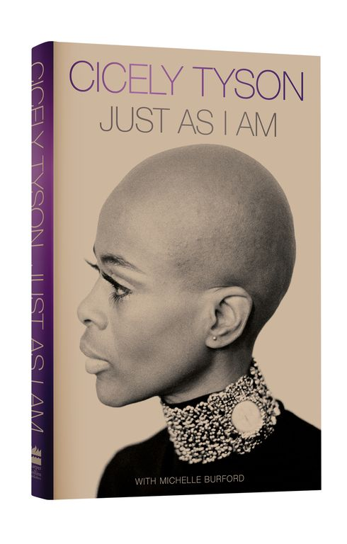
The legacy lives on
Cicely Tyson released her autobiography on January 26, 2021.
Two days later at 96 years old, she died.
Notes:
Read the slide aloud for the students.

Slide 12
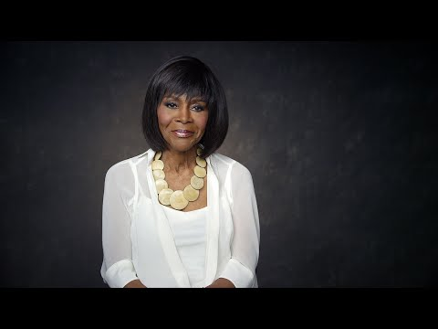
Gone but not forgotten
Notes:
https://www.youtube.com/watch?v=65YduIHohIE
Play the video for the students (3:40).

Slide 13
Check out would you rather make
Money
An impact
Notes:
Engage the students in this check out question.

Slide 14
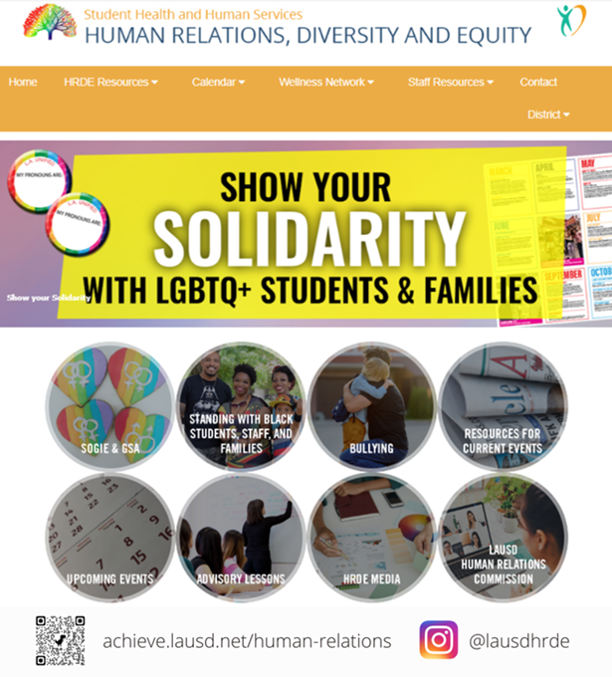
Human relations, diversity & equity

Slide 15
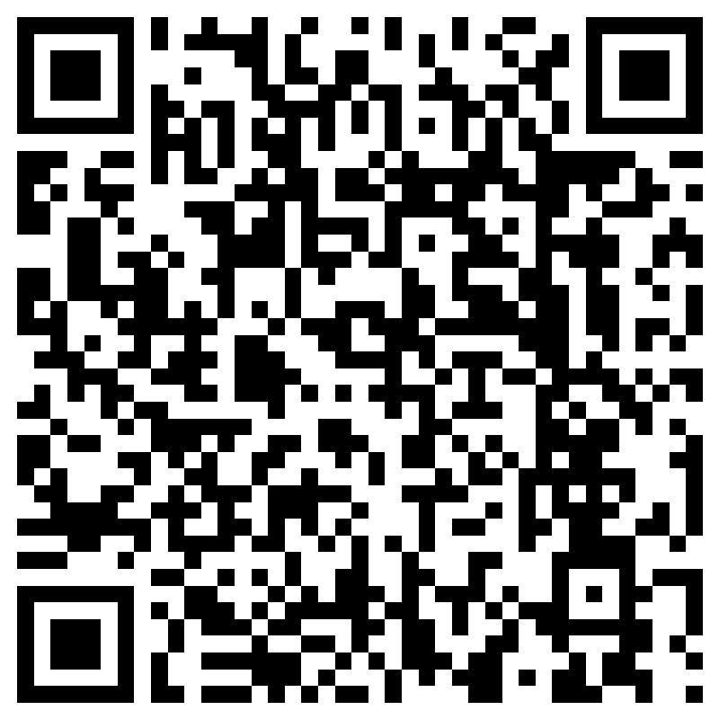
Teacher Survey
Notes:
Teacher, please complete the brief survey by scanning the QR code or using the link below.
https://forms.office.com/r/i9UqyyxzTT

